Slide 1
Airbnb NY Datamining
- Divy, Jay, Smit, Shilp Patel

Slide 2
Intro
Guests and hosts have been using Airbnb since 2008 to broaden travel opportunities and to present a more unusual, individual experience of the world. In this dataset the interaction and measurements in NYC, 2019 are described. This public dataset is part of Airbnb and is available on this website. The original source.
http://insideairbnb.com/new-york-city/
What types of areas and hosts we can learn?
What can we forecasts? (e.g. prices, rates, feedback, etc.)
Which areas of hosts are the busiest and why?
Is there any noticeable differences in traffic between different areas and why?

Slide 3
Goals
This project focuses on the patterns and other relevant Airbnb listing information in NYC.
We will find out how are rental properties distributed across the neighborhoods of NYC
How do prices vary with respect neighborhoods, rental property types and rental amenities.
How can computer learning models be equipped to forecast rental prices for Airbnb using features like the type of property that can be rented, number of people that can be rented, number of beds available and so on?
New York City (NYC), with more than 48 000 rentals in the calendar year from August 2019 (which correlates to a rental rate of 48000 rentals per 468 square miles, equating to a maximum of 102 rents / square miles), has a very strong Airbnb industry.

Slide 4
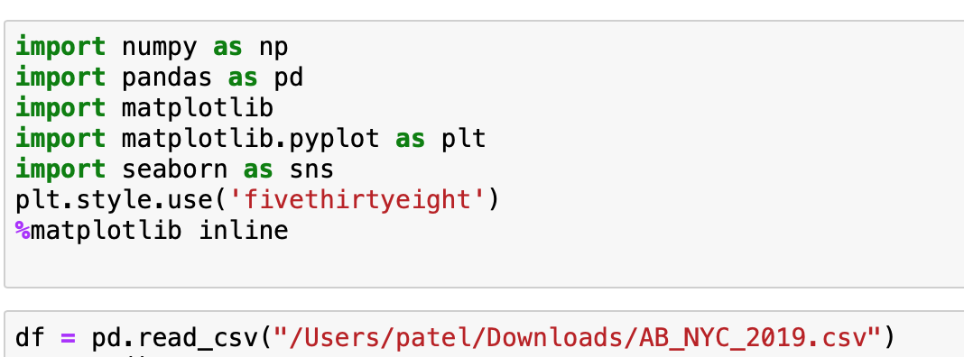
Importing Libraries and data set

Slide 5
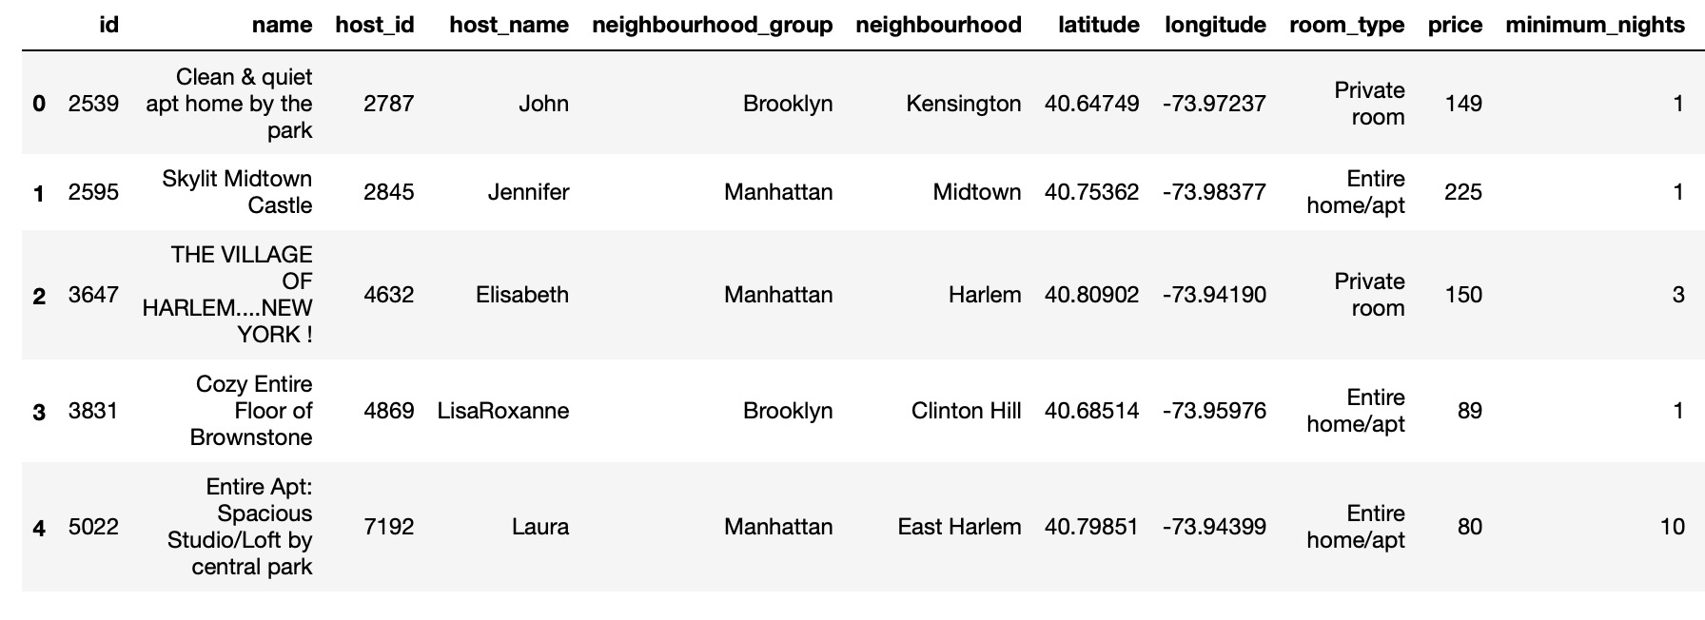
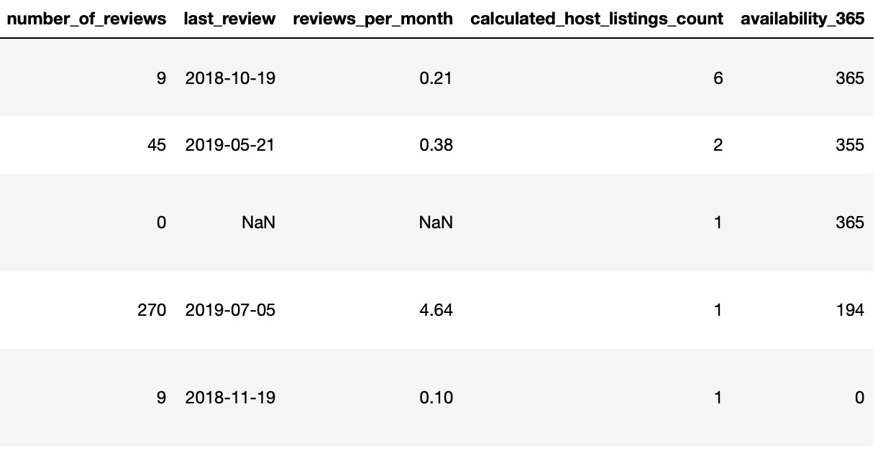
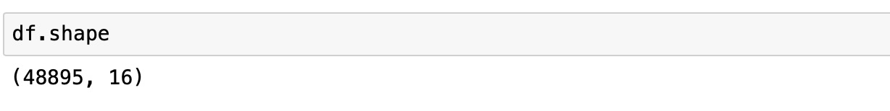
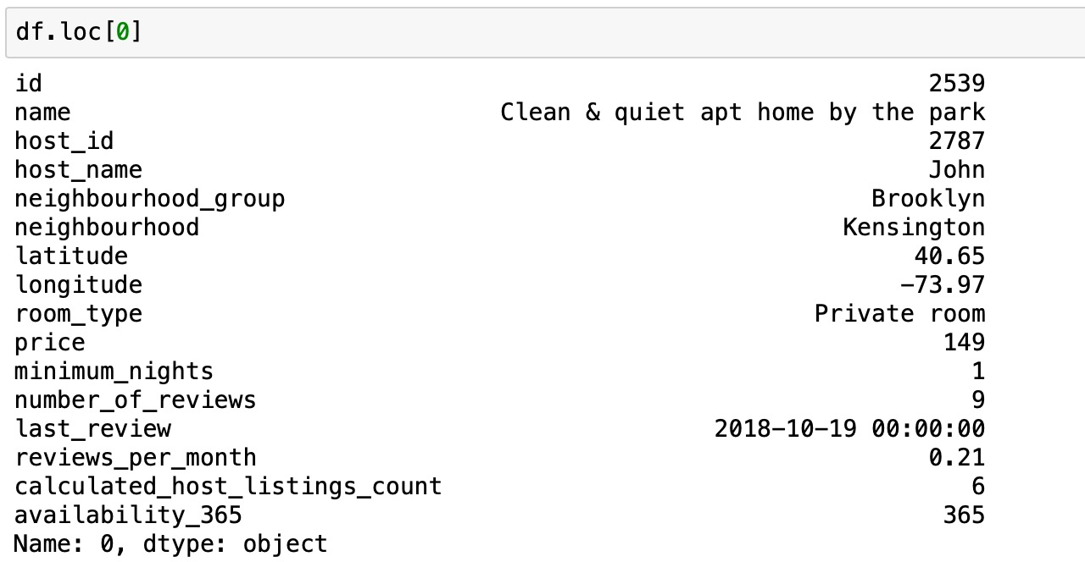
Exploratory Data Set

Slide 6
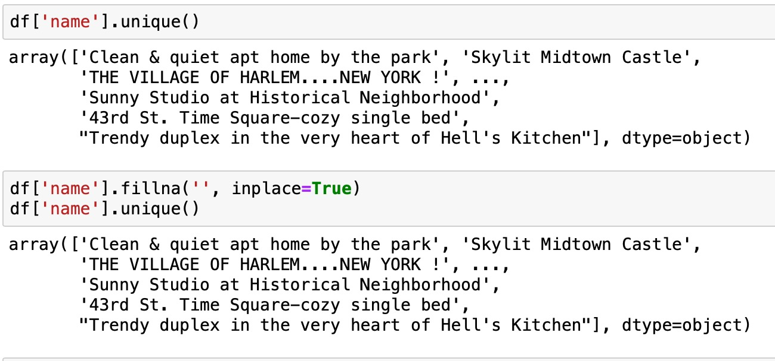
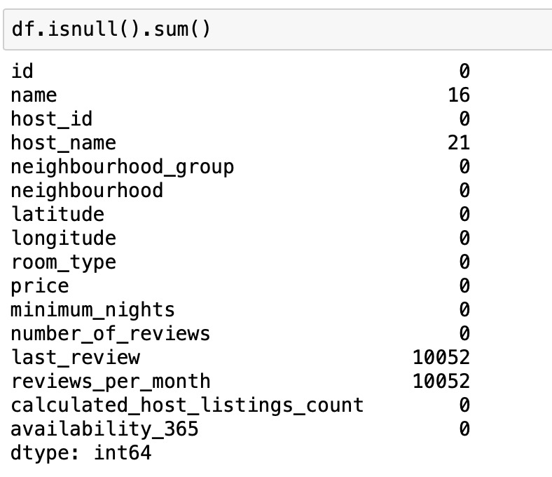
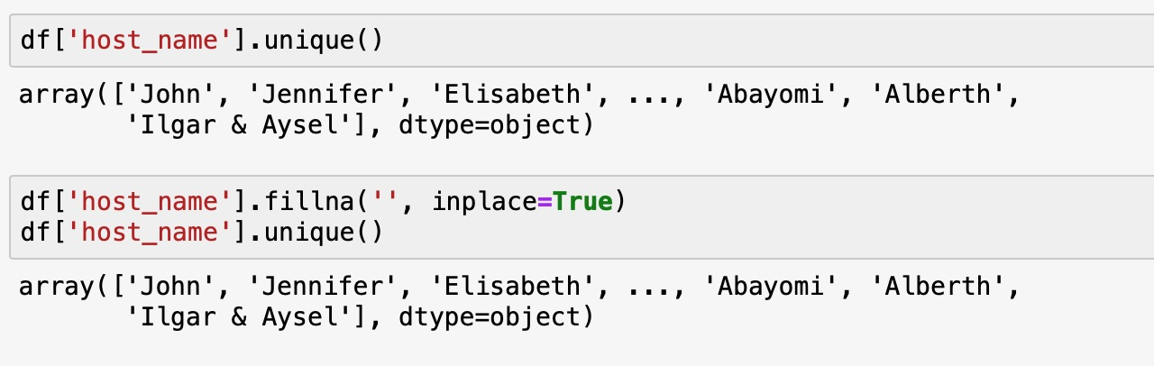
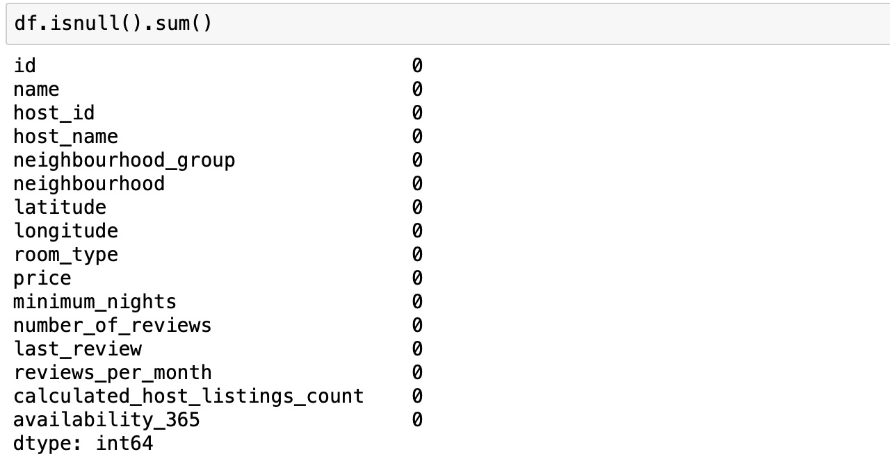
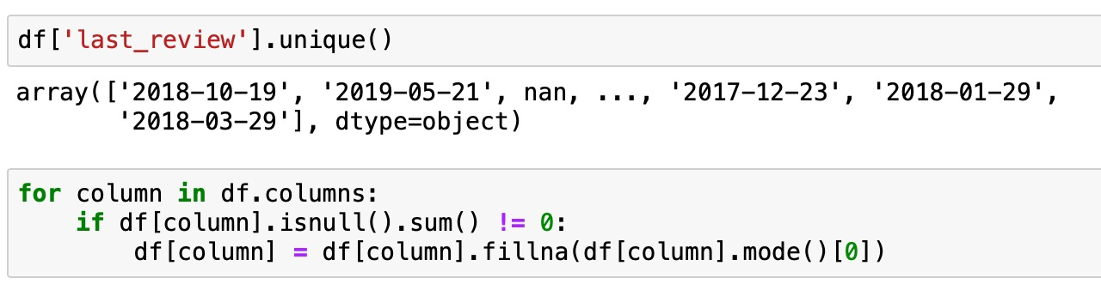
Preprocessing

Slide 7
Density visualization

Slide 8
Density visualization

Slide 9
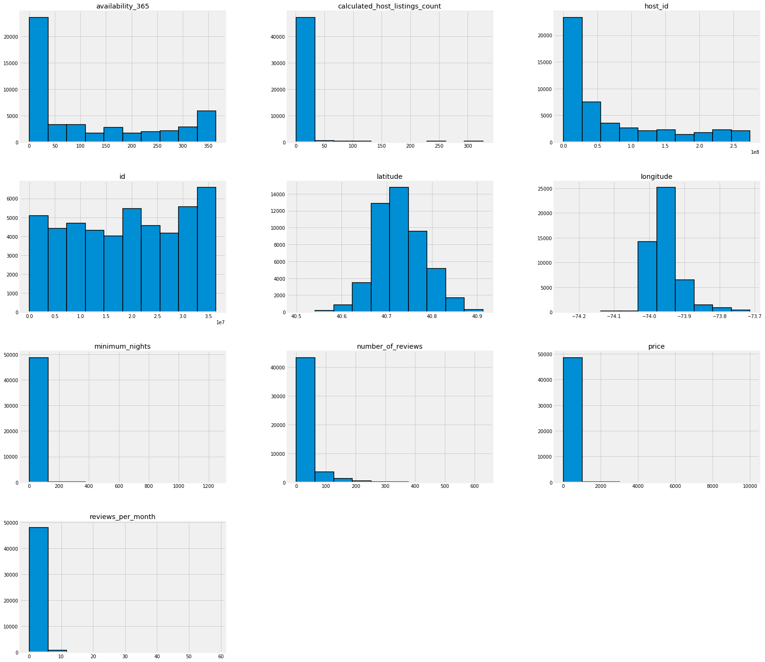
Data Visualization

Slide 10
Analysis
descriptive
diagnostic
predictive

Slide 11
Descriptive Analysis

Slide 12
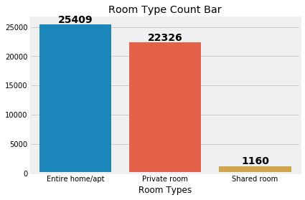
Number of Room Types Available

Slide 13
Percentage Representation of Neighborhood Group in Pie

Slide 16
Distribution Price by Neighbourhood Groups

Slide 17
Top 10 Host IDs

Slide 18
Diagnostic Analysis

Slide 19
HeatMap Correlation

Slide 20
Predictive Analysis

Slide 21
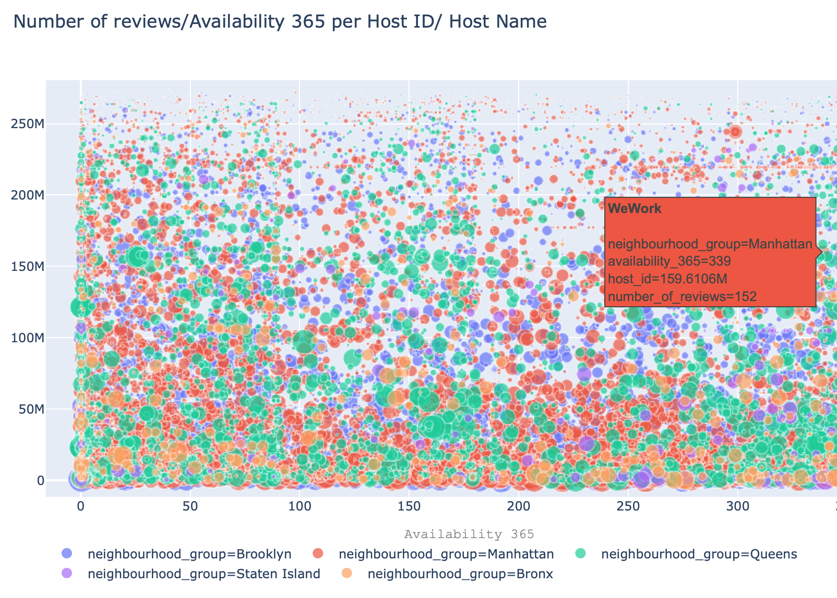
Scatter Graph showing Number of reviews/Availability 365 per Host ID/ Host Name

Slide 22
Data Visualization

Slide 23
Spatial Analysis by Neighbourhood Groups

Slide 24
Price Overview in a HeatMap Normalization

Slide 25
Algorithm
Linear Regression
Gradient Boosted Regressor
K-means

Slide 26
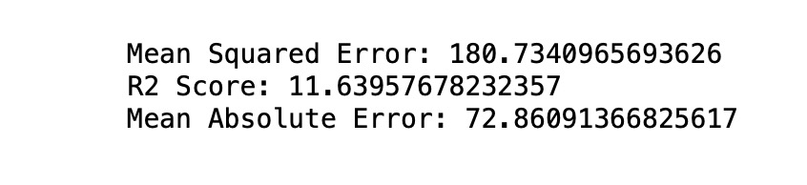
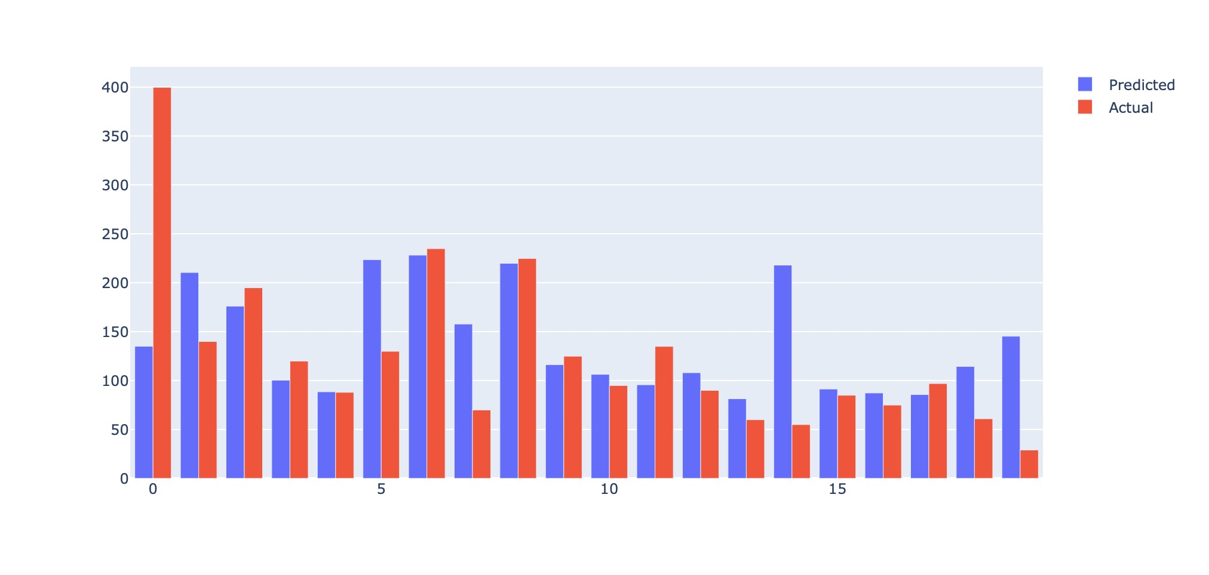
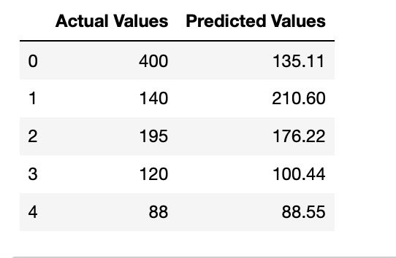
LINEAR

Slide 27
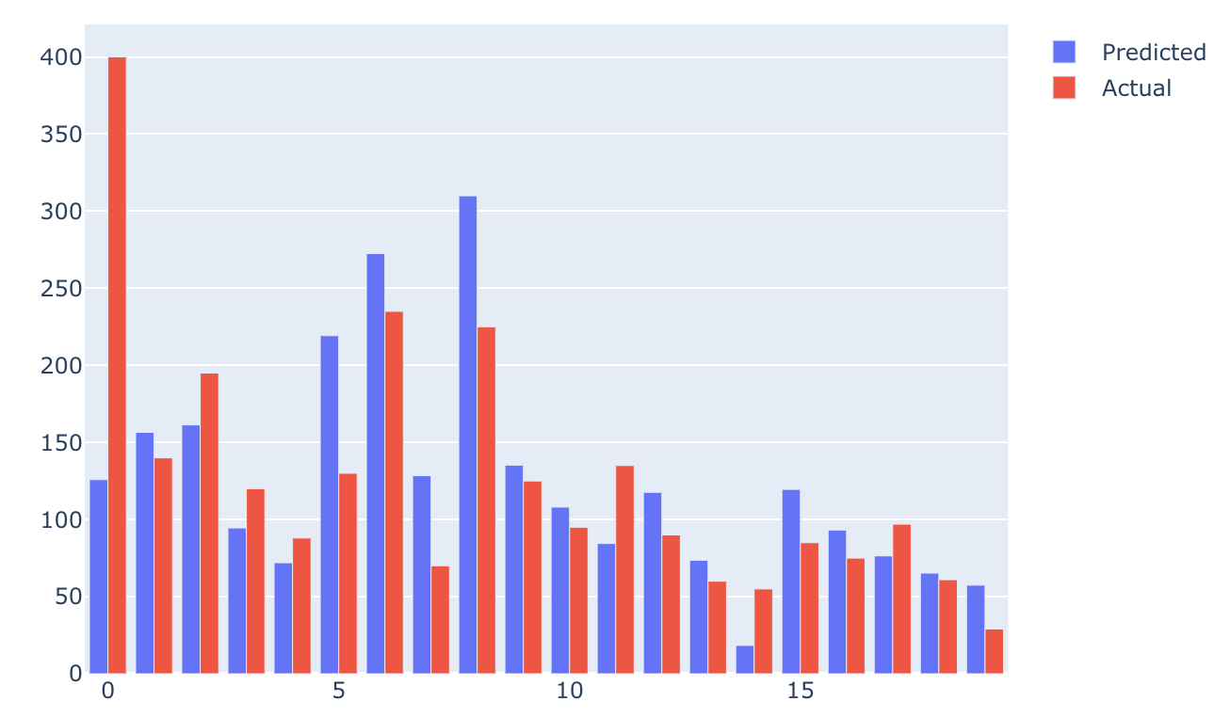
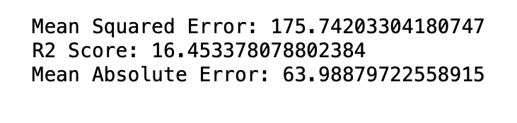
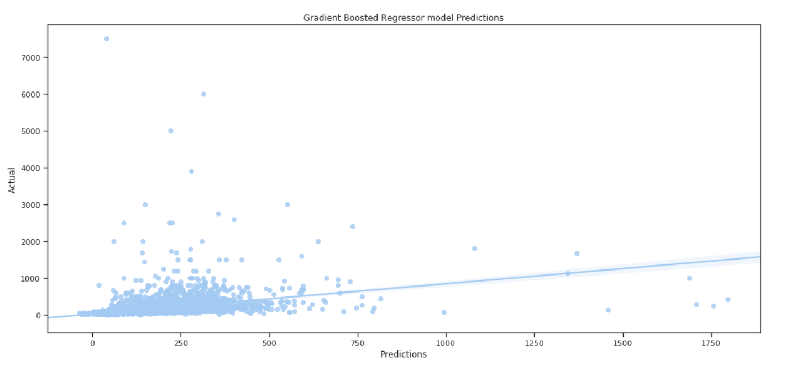
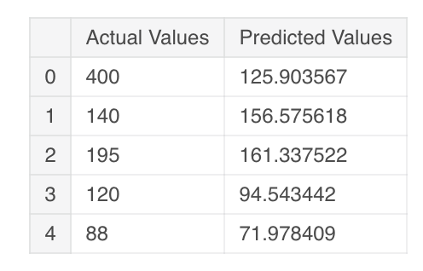
Gradient Boosted

Slide 28
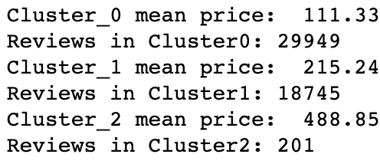
K-Means

Slide 29
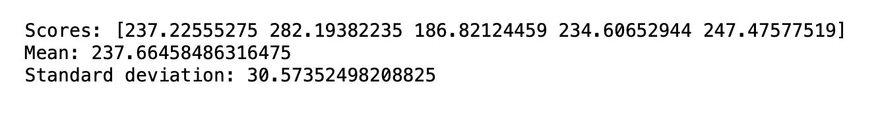
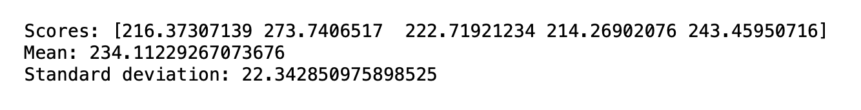
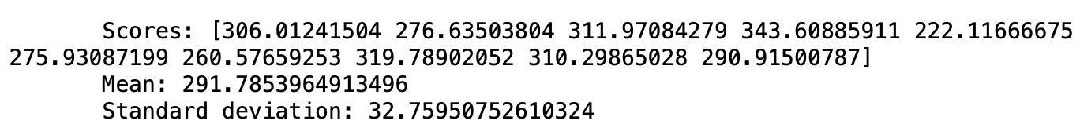
K fold
Linear Model:
Gradient Boosted Model:
K mean:

Slide 30
Conclusion

